Slide 1
Name : Bhavanam Sravani ASSIGNMENT :1
1. Create three instance
Attach one EFS to two instance
Attach one EBS to one instance

Slide 2
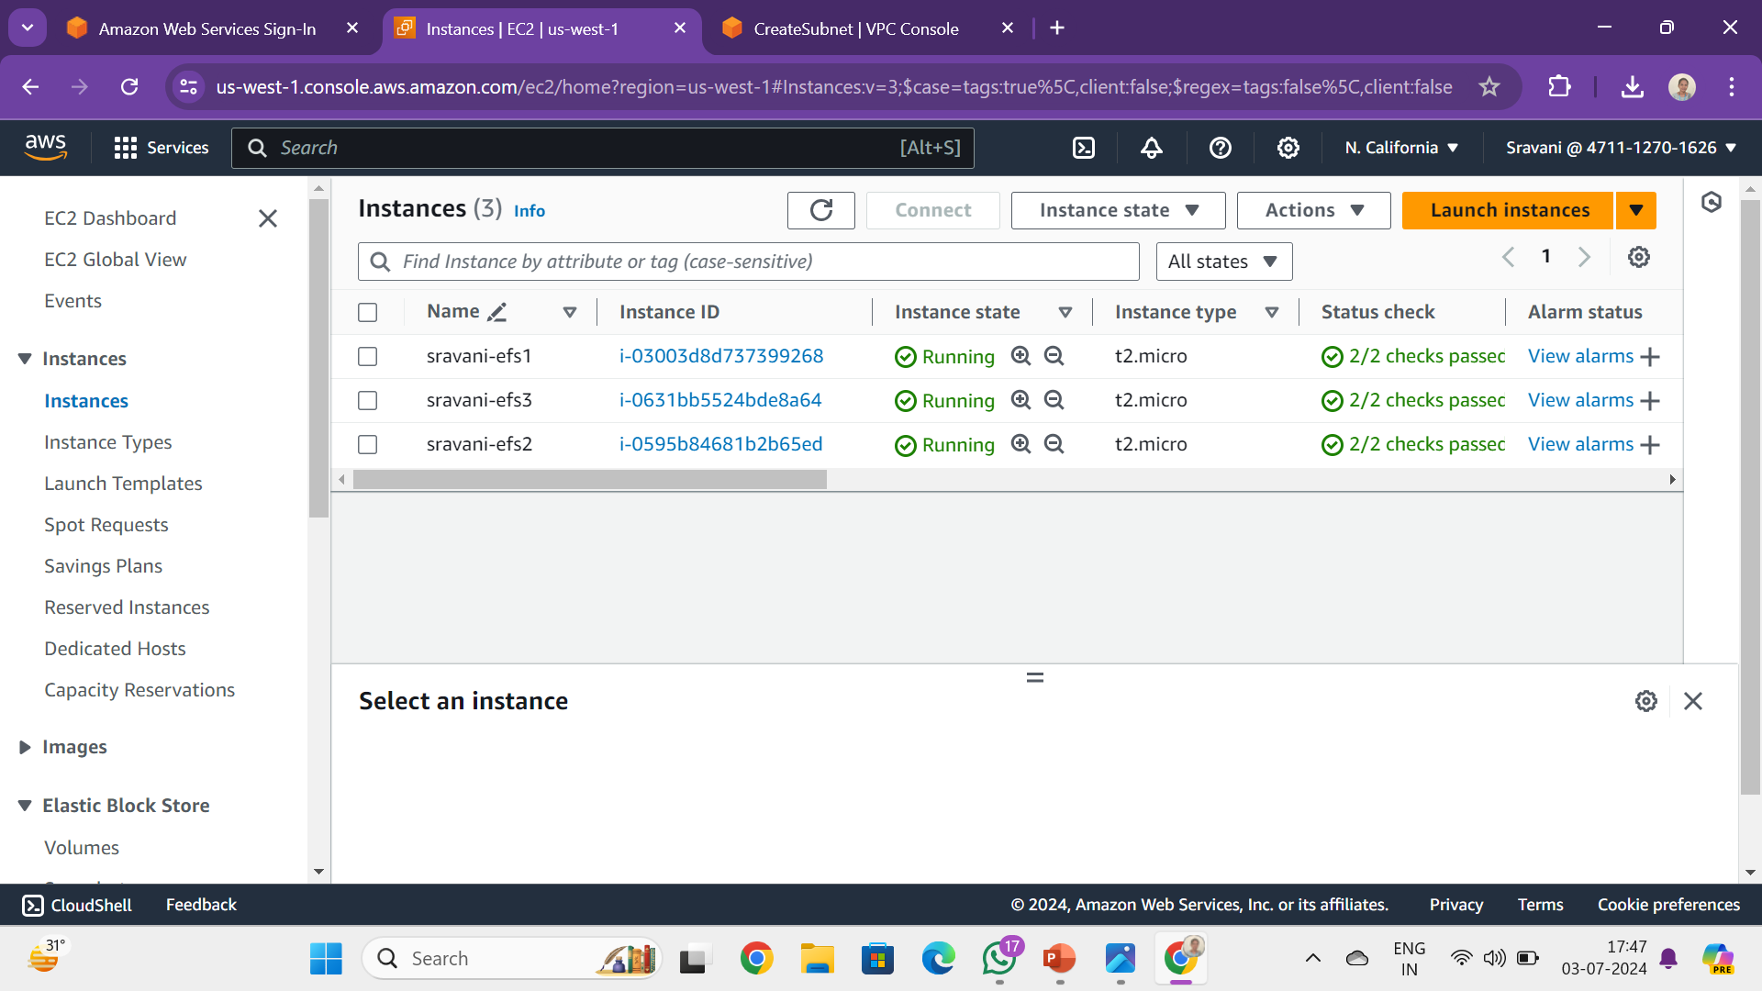
CREATING THREE INSTANCE

Slide 3
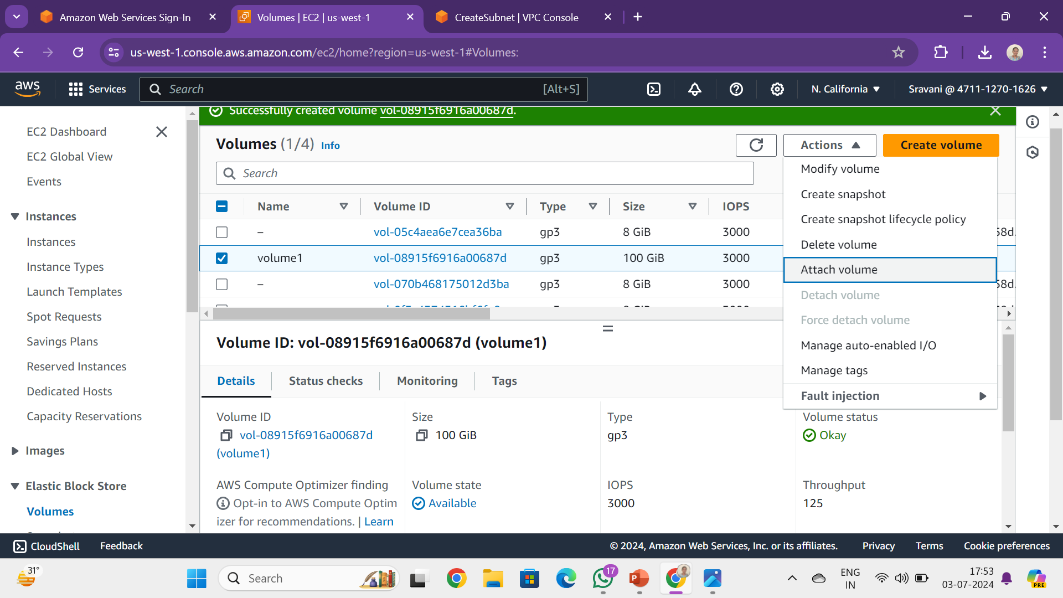
1.ATTACH ONE EBS TO ONE INSTANCE first create a volume

Slide 4
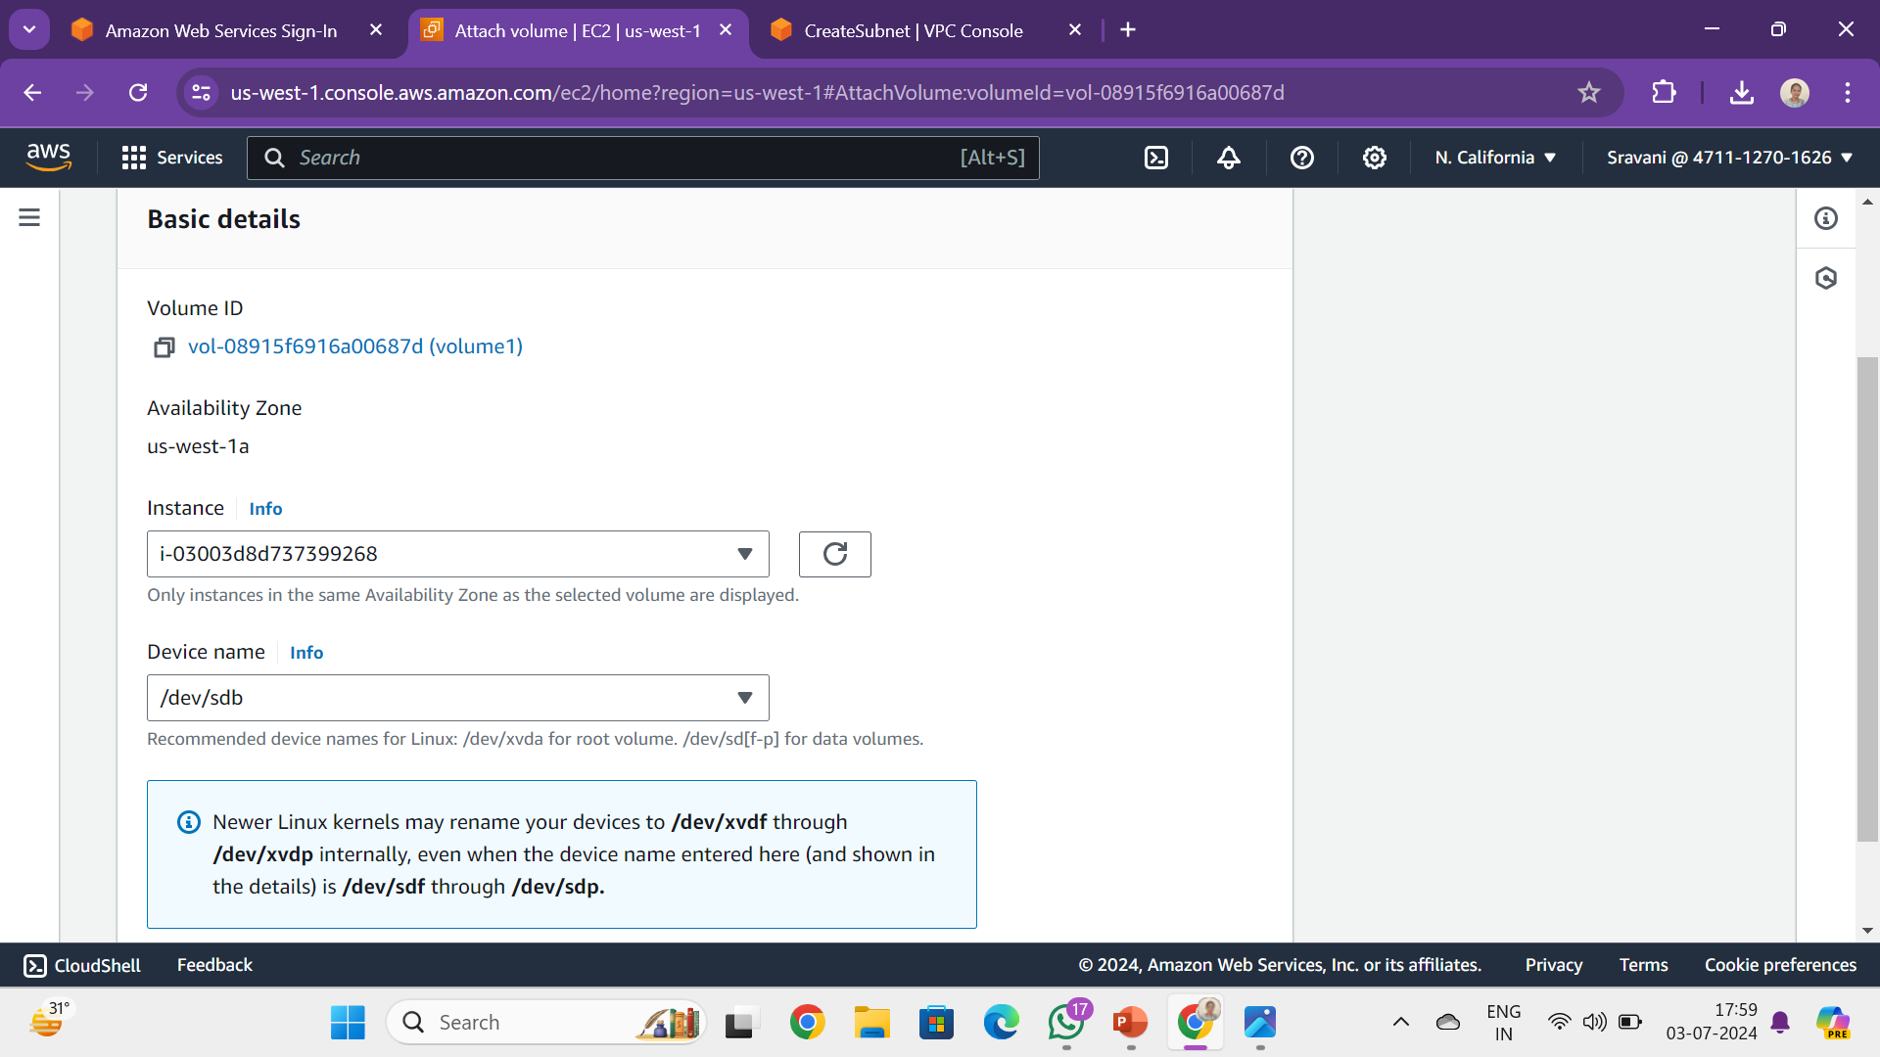
Attach volume to an instance

Slide 5
process :
List the all block device’s in linux machine
Check if there any file system on this device
Create file system
Check if there any file system on this device
Create a directory
Mount the directorys
Check the disk free space

Slide 6
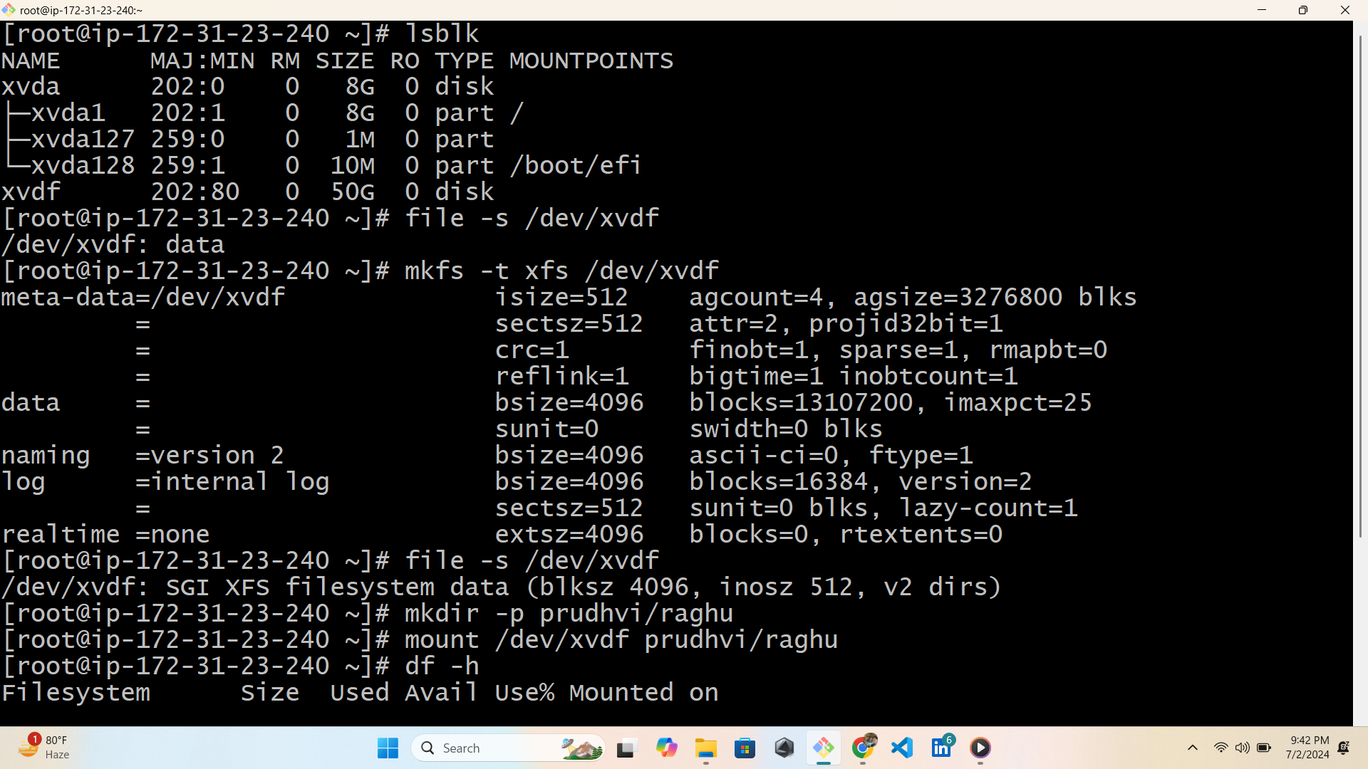
List all block device by using “ lsblk ” command Check file system by using “ file –s /dev/xvdf ”commend Create directory by using “ mkdir –p app/user “ command

Slide 7
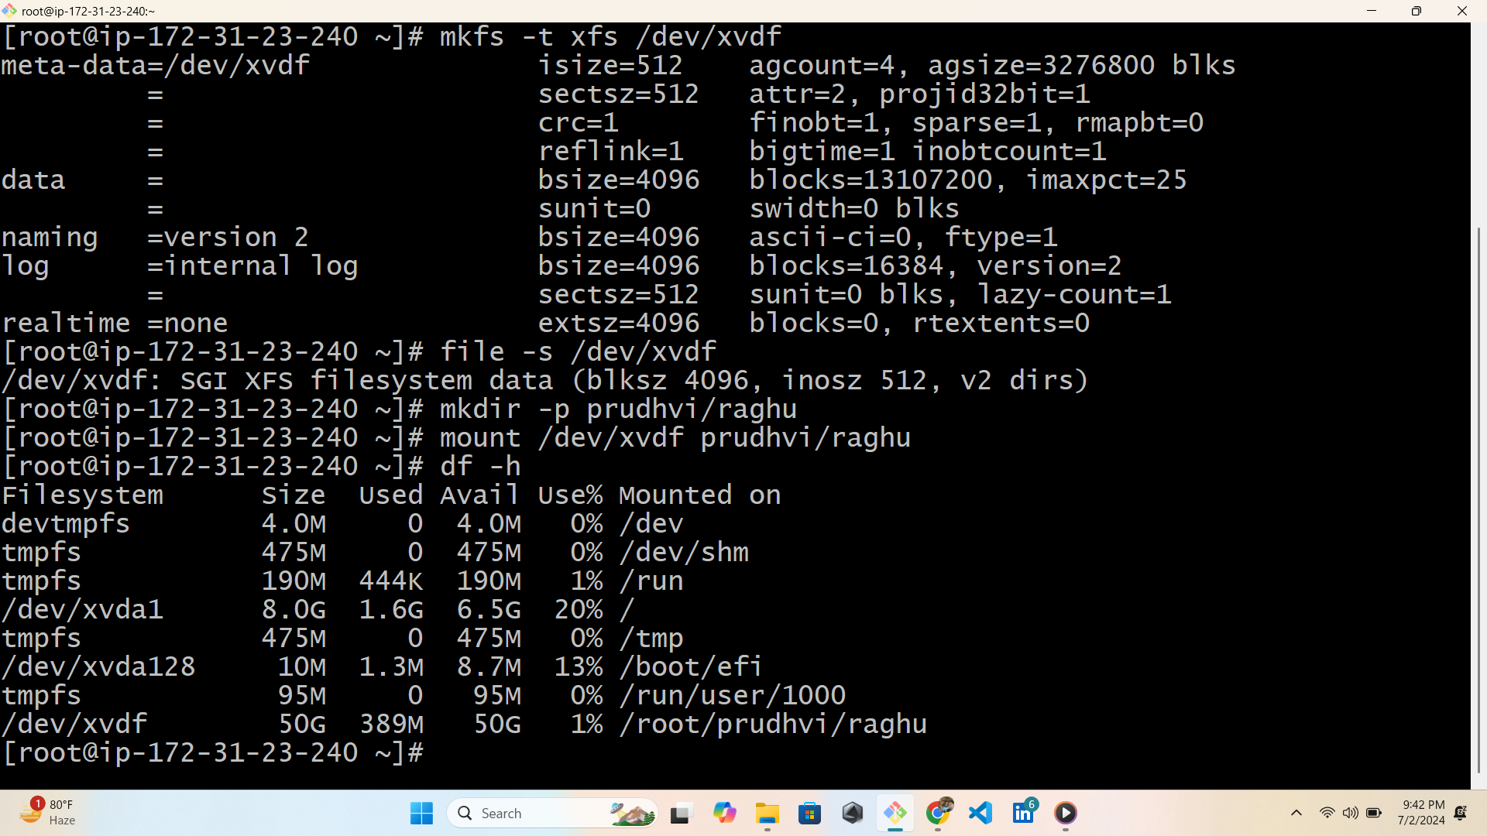
Mount the directory by using “ mount /dev/xvdf app/user “ command To check disk free by using ‘’df –h’’ command

Slide 8
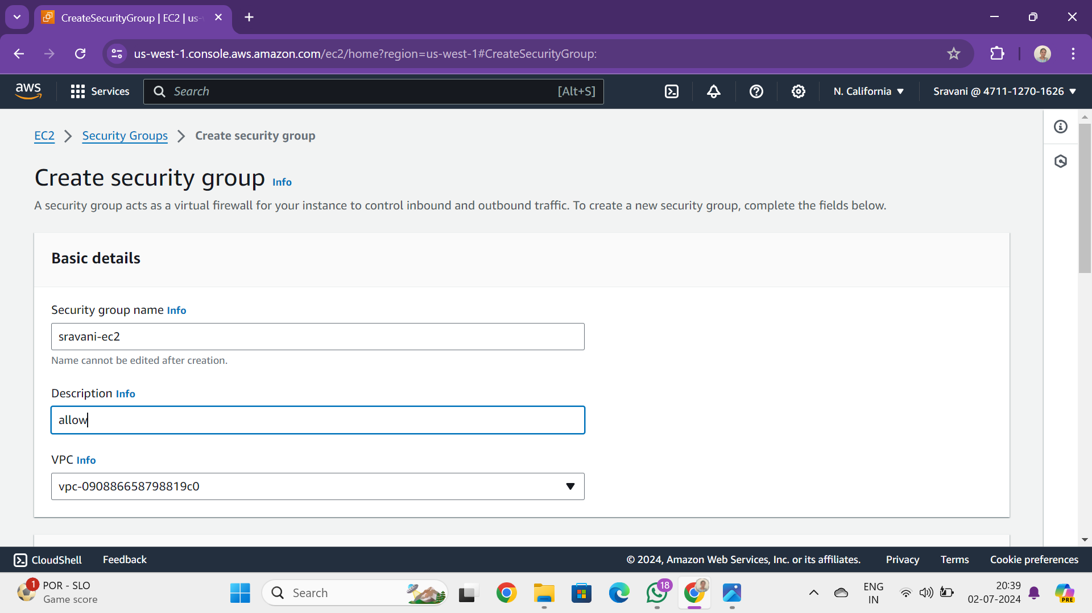
B. Attach one EFS to two instance create a security group

Slide 9
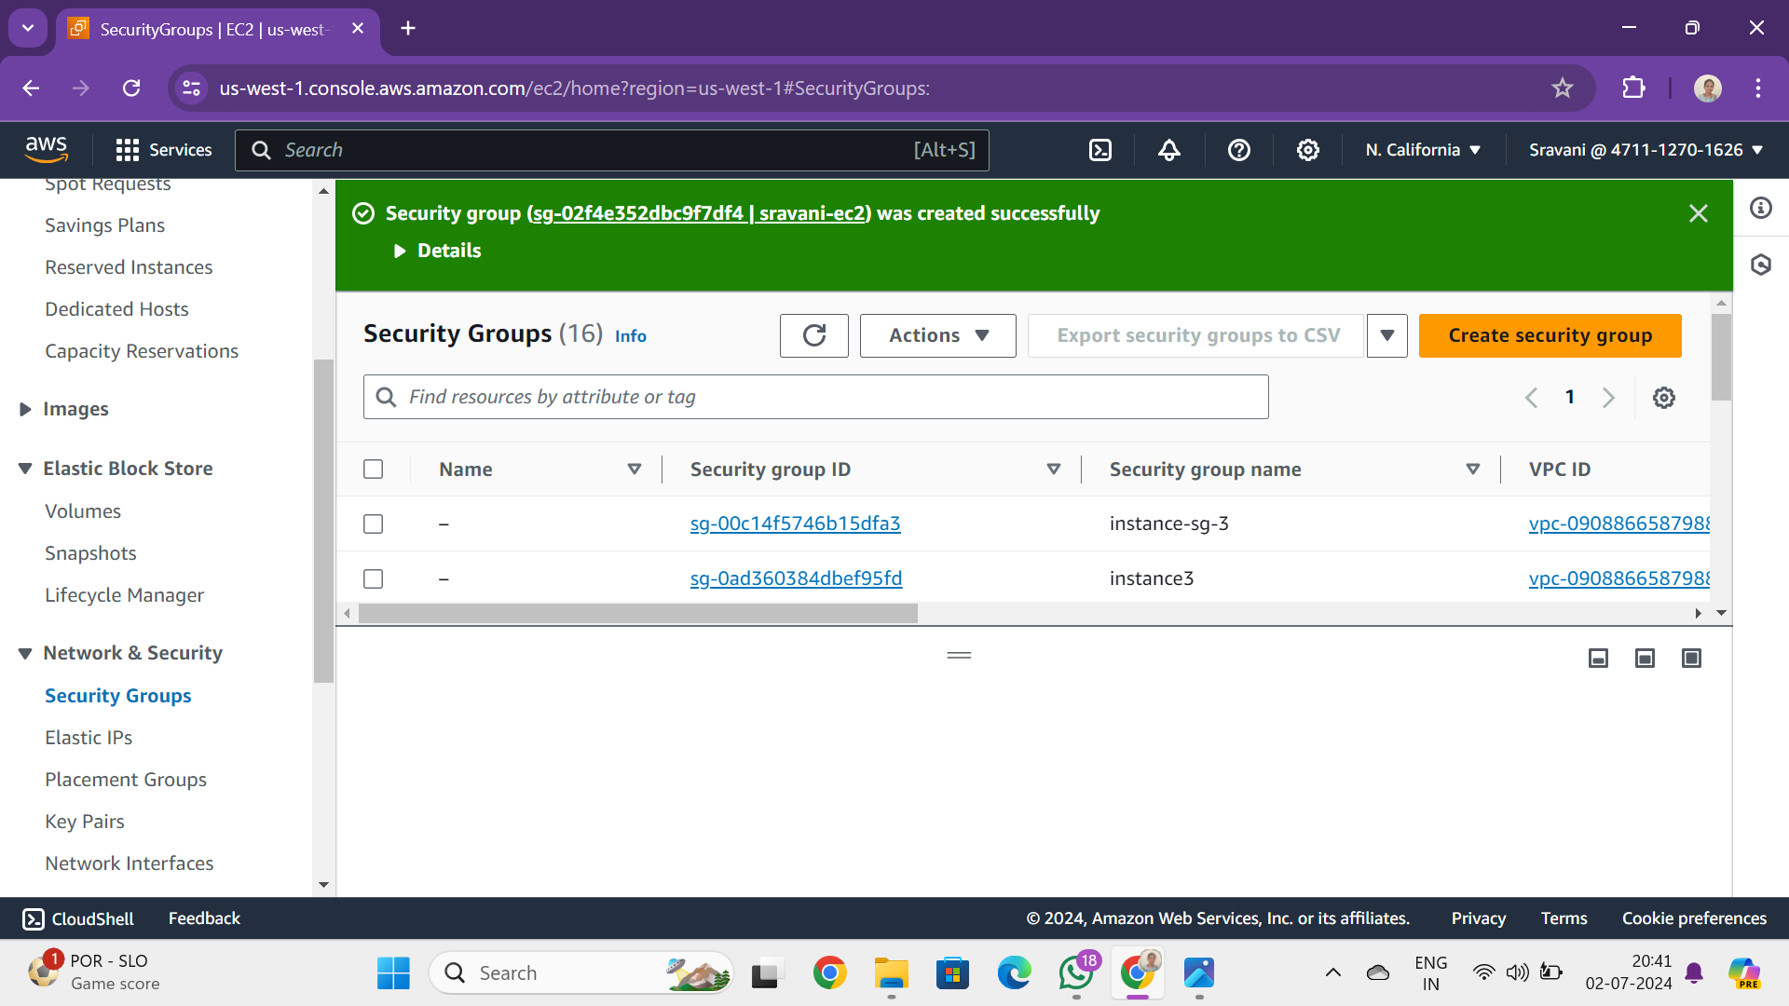
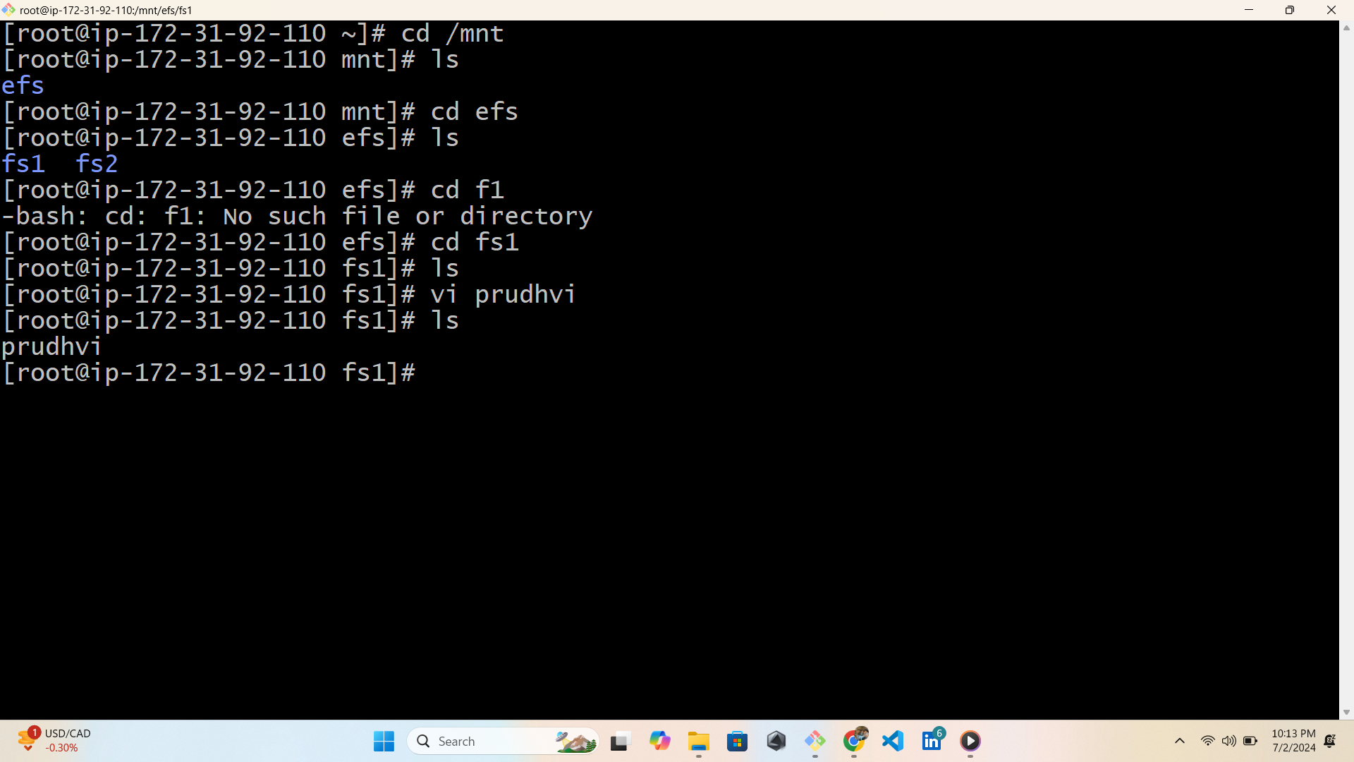
Create a EFS file system

Slide 10
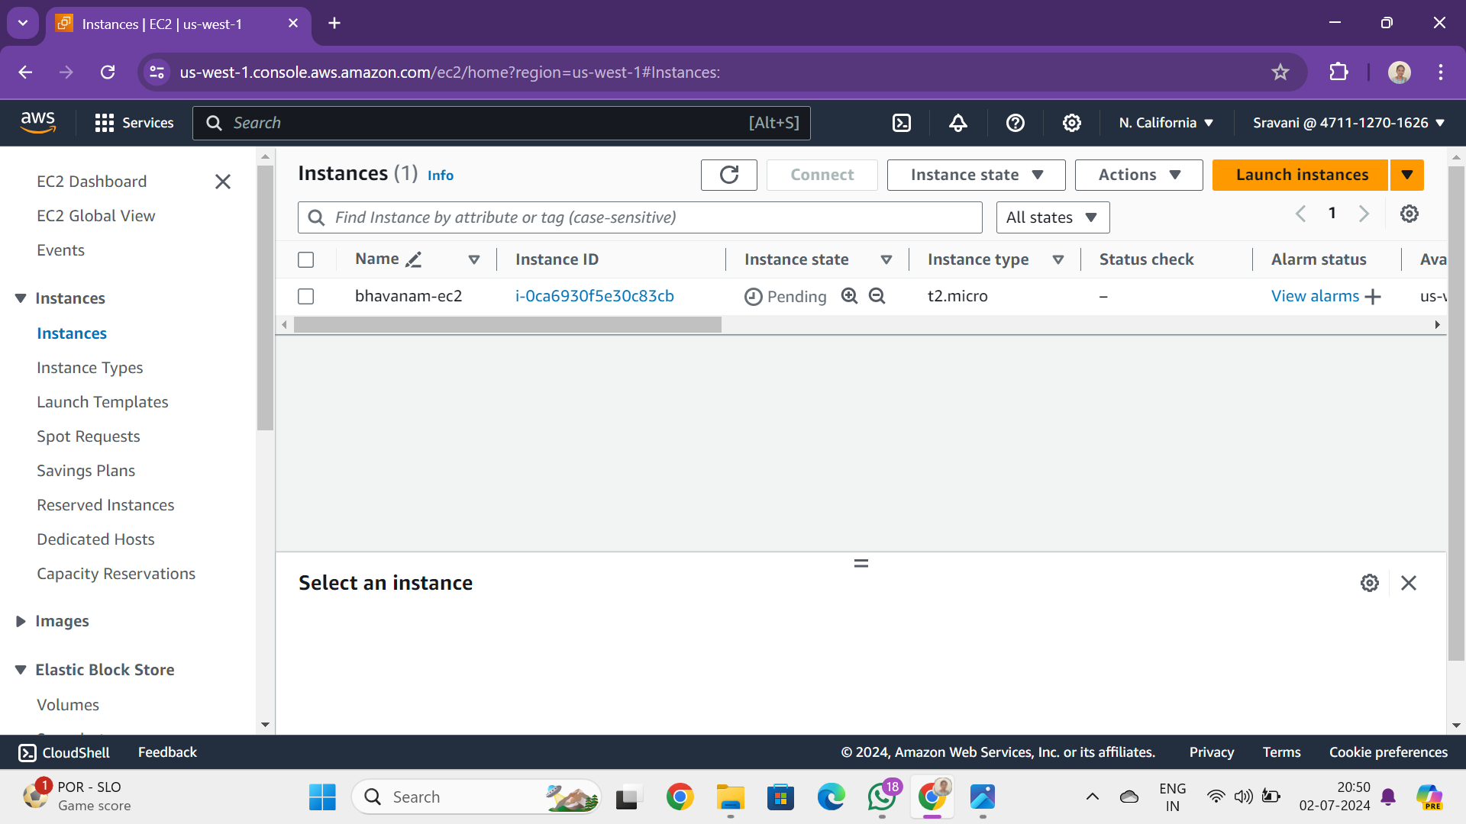
Launch two instance with different zones and connect instances

Slide 11
EFS - Elastic File Storage
It is designed to share parallelly with thousands of EC2 instances to provide better throughput
and IOPS. It is a regional service automatically replicated across multiple AZ's to provide High
Availability and durability.
In server1
Create a file system in one server
Store some data in that file system
In server2
Create a file system in one server
Store some data in that file system
Both servers shares same file and data these type of data sharing is known as EFS

Slide 12
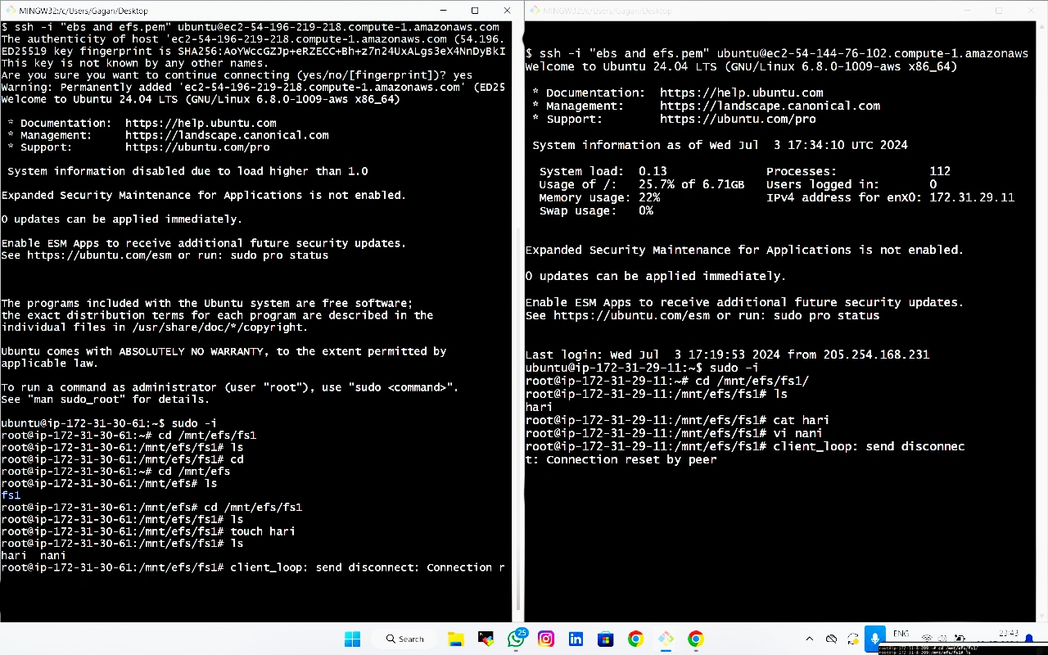
EFS1

Slide 13
EFS 2

